Slide 1

Prama VodCast
An AI-Powered Video Podcast Generator
A free, open-source tool that transforms text into professional video podcasts using AI voice cloning and avatar lip-sync technology.

Slide 2
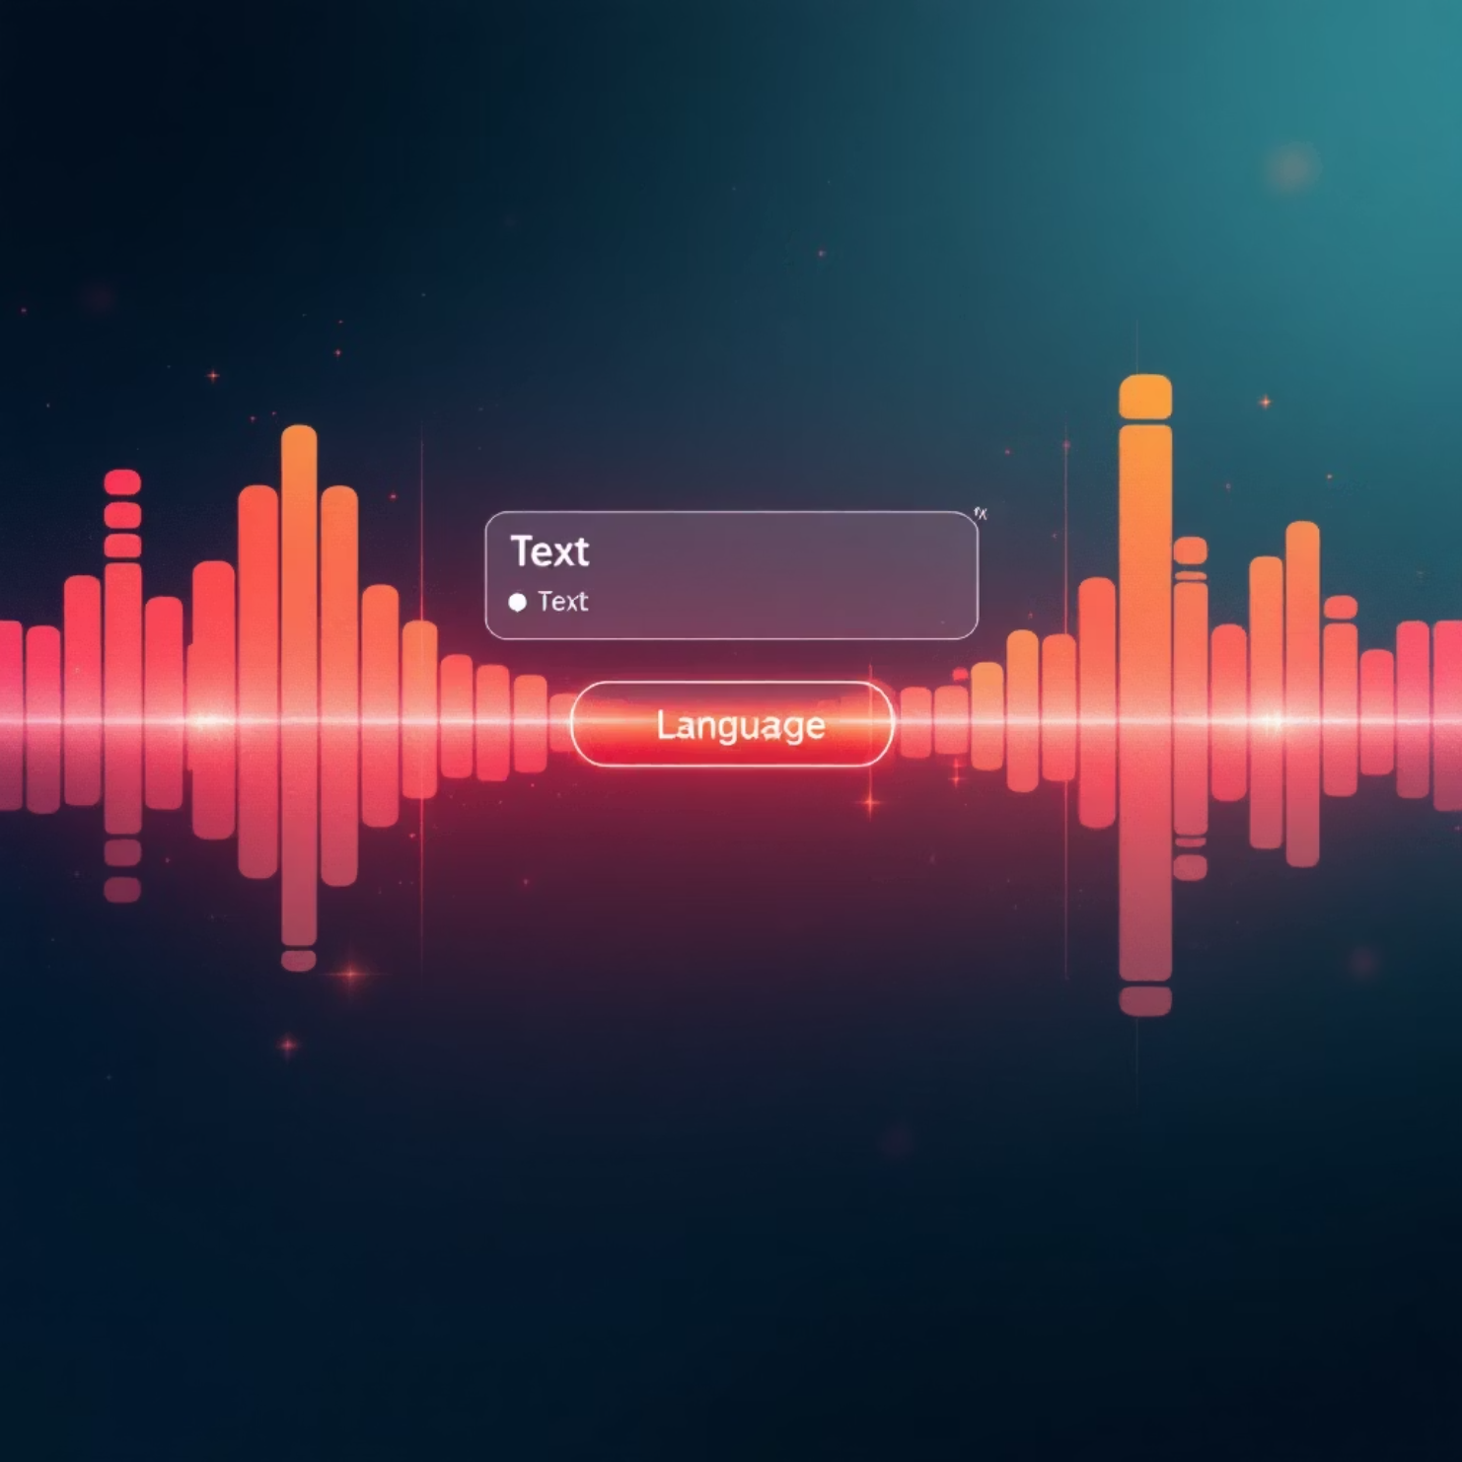
Text to Speech Conversion
Our portal provides a seamless text-to-speech pipeline:
Input Flexibility
Upload text files or directly paste content into the text box
Language Selection
Convert text to audio in multiple languages with natural-sounding results
Technology Stack
Built with Python backend and React frontend for responsive performance

Slide 3




Speech Cloning
Upload Sample Audio
Provide a clear audio sample of the target voice through our portal
AI Model Training
Our system analyzes voice characteristics and trains a custom voice model
Voice Cloning
Generate natural-sounding speech in the cloned voice using your script
The system preserves intonation, accent, and speaking style for authentic results.

Slide 4

Avatar Video Generation
Creating Lifelike Talking Heads
Our technology transforms static images or sample videos into dynamic talking avatars:
Upload a video sample of your chosen avatar
AI analyzes facial movements and expressions
Sophisticated lip-sync technology matches mouth movements to generated audio
Final output creates natural-looking talking head videos

Slide 5



Tools & Technologies
Open Source Foundation
Deployment & Portability
AI Infrastructure
Built entirely with free, open-source tools and models
Docker containers for cross-platform compatibility
Research powered by ChatGPT, Deepseek, and Grok
GitHub repository with complete source code
Google Cloud Platform deployment options
Free model access via Openrouter and Huggingface APIs
Google Colab testing environment
Leverages F5-TTS, SadTalker, and Wav2Lip

Slide 6

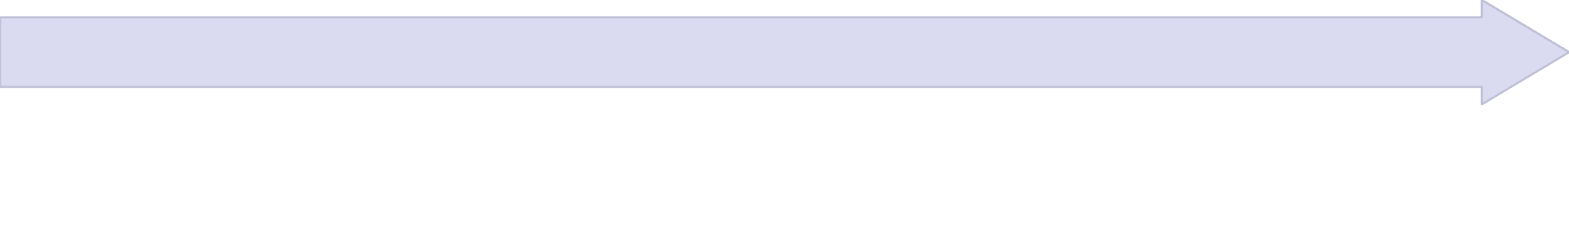

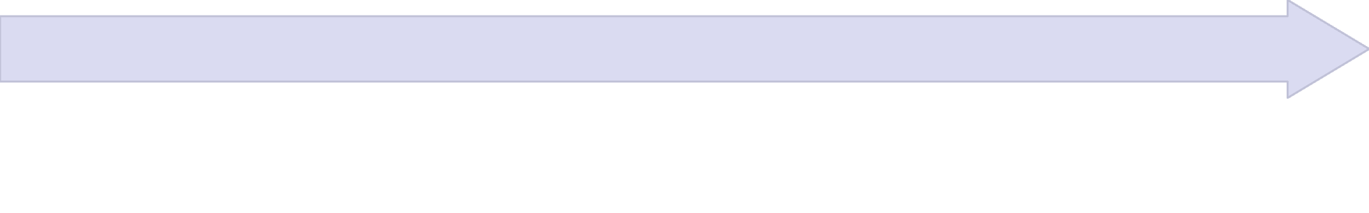
YouTube Deployment
Streamlined Publishing Workflow
Prama VodCast offers seamless YouTube integration:
Connect Account
Link your pre-created YouTube account credentials
Configure Settings
Set video metadata, visibility, and publishing schedule
Auto-Publish
Videos automatically uploaded and made public

Slide 7
Technical Features & Implementation
User Portal
AI Components
Get Started
Clean, intuitive web interface
LLM-powered research capabilities
GitHub Repository:
Secure authentication with user/password
github.com/pramod-prama/Vodcast
F5-TTS for text-to-speech conversion
Role-based access control
Clone the repo and follow the documentation to deploy your own instance today!
Input/output management system
SadTalker and Wav2Lip for avatar animation
Fine-tuning options for custom voices

